Slide 1
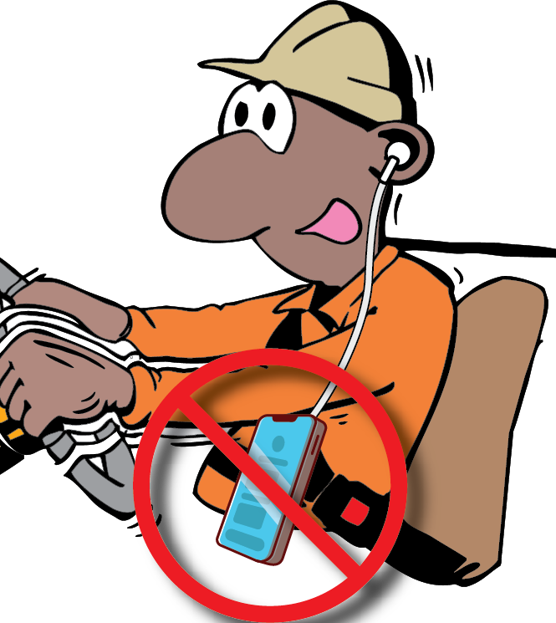
OTML Safe Driving
Rewards Program
In our efforts to reduce the increasing number of significant vehicle and mobile equipment incidents, an OTML Safe Driving Rewards Program was designed and implemented in Jan 2023 to encourage safe driving behaviors and fit for purpose vehicles on site.
All OTML employees, business partners (BP) and visitors/consultants are encouraged to participate in this program.
Employees are encouraged
to intervene and report any at-risk driving behaviors they observed or
report any defect or unsafe/hazardous conditions of vehicle or mobile equipment on OTML sites.
Positive reinforcement on safe driving behaviors with drivers is also encourage
OTML – OHS – PRO – 2.114 and 2.115 – OTML Safe Driving Rewards Program 2024 (V3)

Slide 2
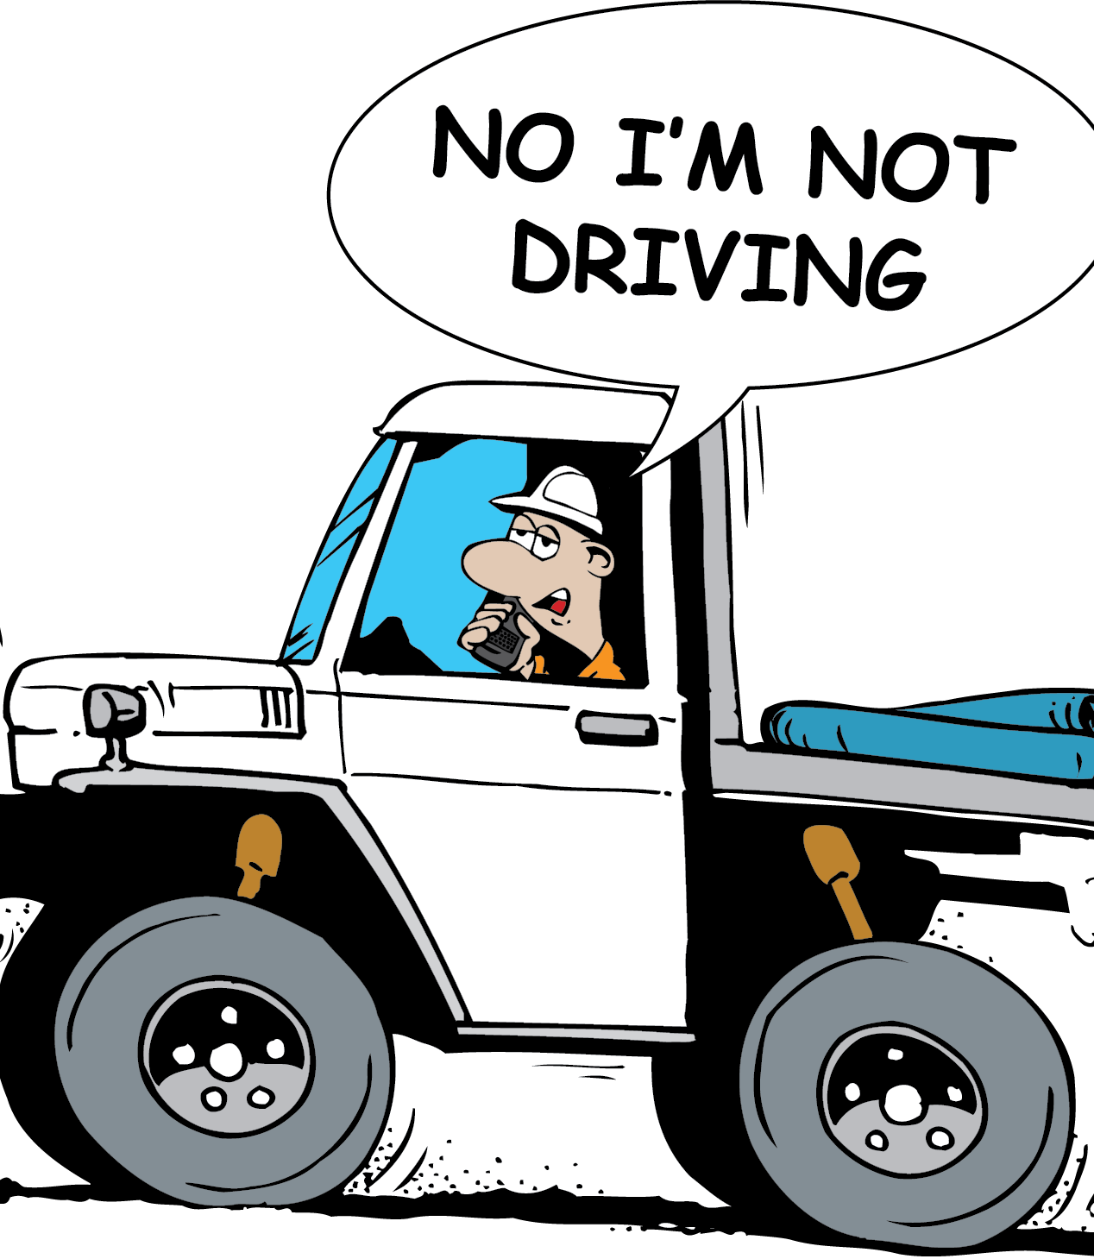
Steps to Participate in the Program
An at-risk driving behavior is observed, or a defect / hazardous condition of vehicle or mobile equipment is identified.
Individual is encouraged to intervene and have the discussion with the driver or operator of their at-risk driver behavior or on the defect/hazardous condition of the vehicle or mobile equipment being operated on.
Individual must report the observation on
an OTML Observation & Interaction (O&I) card for any at-risk driving behavior, or
on an OTML Hazard ID card for defects or hazardous condition of the vehicle or mobile equipment. A Hazard ID card can also be used by the driver to report where a Category A defect has been identified during a pre-start check, and vehicle or mobile equipment stood down for defect to be rectified.
OTML – OHS – PRO – 2.114 and 2.115 – OTML Safe Driving Rewards Program 2024 (V3)

Slide 3
Steps to Participate in the Program - cont.
The O&I or Hazard ID card must be entered into the INX InControl System. All supporting documents must be uploaded to verify observation. For BPs, contact your BP or OTML Safety reps to assist with entering the report into the system.
Note: Any non-compliance to road safety rules must also be reported to APD Security for a Demerit Point System (DPS) to be applied.
Key findings from the observation must be shared at the next pre-start/ toolbox meetings.
Each bimonthly, OTML Safety will select the top 3 O&I or Hazard ID card from each BU, and reward and recognize individuals (observers).
Note: Criteria for selection will be based where;
the risk exposure has been significantly reduced, and
individual has followed through with the O&I process to intervene, have the discussion with driver /operator and shared key findings at the pre-start meeting
For further information contact your respective OTML Safety Team.
OTML – OHS – PRO – 2.114 and 2.115 – OTML Safe Driving Rewards Program 2024 (V3)

